Slide 1
AWS S3

Slide 2
What is S3?
Amazon S3 is object storage built to store and retrieve any amount of data from anywhere – web sites and mobile apps, corporate applications, and data from IoT sensors or devices.
By default the S3 Standard , S3-IA and Glacier storage classes replicate the data stored within S3 in three availability zones for HA and disaster recovery scenarios.

Slide 3
S3 Storage Classes
Amazon S3 Standard : Amazon S3 Standard offers high durability, availability, and performance object storage for frequently accessed data.
Amazon S3 Standard – Infrequent Access : Amazon S3 Standard - Infrequent Access (Standard - IA) is an Amazon S3 storage class for data that is accessed less frequently, but requires rapid access when needed.
Amazon S3 One Zone – IA : S3 One Zone-Infrequent Access (S3 One Zone-IA; Z-IA) is a new storage class designed for customers who want a lower-cost option for infrequently accessed data, but do not require the multiple Availability Zone data resilience model of the S3 Standard and S3 Standard-Infrequent Access (S3 Standard-IA; S-IA) storage classes.
Amazon Glacier : Amazon Glacier is a secure, durable, and extremely low-cost storage service for data archiving. You can reliably store any amount of data at costs that are competitive with or cheaper than on-premises solutions.

Slide 4
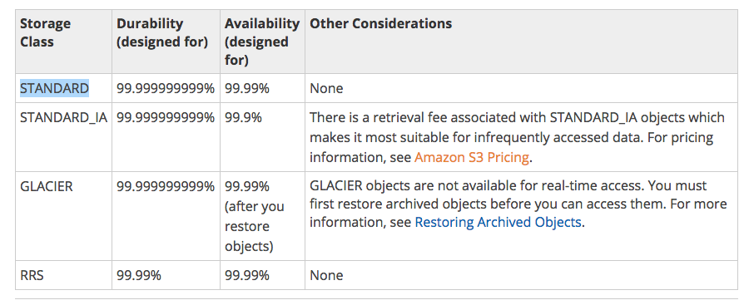
Overview Of Storage Classes

Slide 5
Static Website Hosting
You can host a static website on Amazon Simple Storage Service (Amazon S3). On a static website, individual webpages include static content. They might also contain client-side scripts. By contrast, a dynamic website relies on server-side processing, including server-side scripts such as PHP, JSP, or ASP.NET. Amazon S3 does not support server-side scripting. Amazon Web Services (AWS) also has resources for hosting dynamic websites.

Slide 6
S3 Version Control
Versioning is a means of keeping multiple variants of an object in the same bucket. You can use versioning to preserve, retrieve, and restore every version of every object stored in your Amazon S3 bucket. With versioning, you can easily recover from both unintended user actions and application failures.
In one bucket, you can have two objects with the same key, but different version IDs such as photo.gif (version 213422) and photo.gif (version 231222)
If you delete an object, instead of removing it permanently, Amazon S3 places a delete marker which becomes the current object version. If you overwrite an object, it results in a new object version in the bucket. You can always restore the previous version.

Slide 7
S3 Cross Region Replication
Cross-region replication is a bucket-level configuration that enables automatic, asynchronous copying of objects across buckets in different AWS Regions. We refer to these buckets as source bucket and destination bucket. These buckets can be owned by different AWS accounts.
Note : Amazon S3 encrypts all data in transit across AWS Regions using Secure Sockets Layer (SSL).
Note : You can replicate objects from a source bucket to only one destination bucket. After Amazon S3 replicates an object, the object cannot be replicated again.

Slide 8
S3 Transfer Acceleration
Amazon S3 Transfer Acceleration enables fast, easy, and secure transfers of files over long distances between your client and an S3 bucket. Transfer Acceleration takes advantage of Amazon CloudFront’s globally distributed edge locations. As the data arrives at an edge location, data is routed to Amazon S3 over an optimized network path.

Slide 9
S3 Lifecycle Transition
What?
Lifecycle Transition is a configuration that enables a user to transition all the objects under a particular storage class when the bucket was created to another storage class.
Why?
Some organizations would not be accessing the objects within a bucket frequently or on a day to day basis. Some objects would be accessed only once a month or once in two months, in layman terms infrequently accessed objects. If the same storage class such as S3 standard was maintained for the infrequently accessed objects, the organization would be paying a huge amount but if the objects were transitioned to lower cost storage classes such as S3-IA, OneZone-IA or Glacier, the organization’s costs would be lowered.

Slide 10
Snowball
Snowball is a petabyte-scale data transport solution that uses secure appliances to transfer large amounts of data into and out of the AWS cloud.
Three pricing models
Snowball
Snowball Edge
Snow Mobile

Slide 11
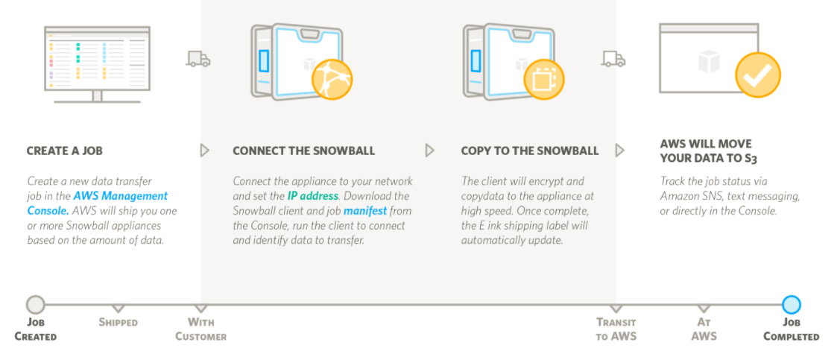
Snowball Process

Slide 12
CloudFront
Amazon CloudFront is a web service that speeds up distribution of your static and dynamic web content, such as .html, .css, .js, and image files, to your users. CloudFront delivers your content through a worldwide network of data centers called edge locations. When a user requests content that you're serving with CloudFront, the user is routed to the edge location that provides the lowest latency (time delay), so that content is delivered with the best possible performance. If the content is already in the edge location with the lowest latency, CloudFront delivers it immediately. If the content is not in that edge location, CloudFront retrieves it from an Amazon S3 bucket or an HTTP server (for example, a web server) that you have identified as the source for the definitive version of your content.

